Slide 1
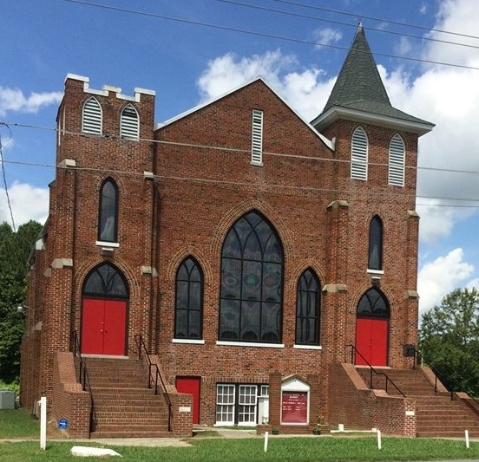
New Allen Memorial a.m.e. church Annual Homecoming 2023
Advertisements

Slide 5
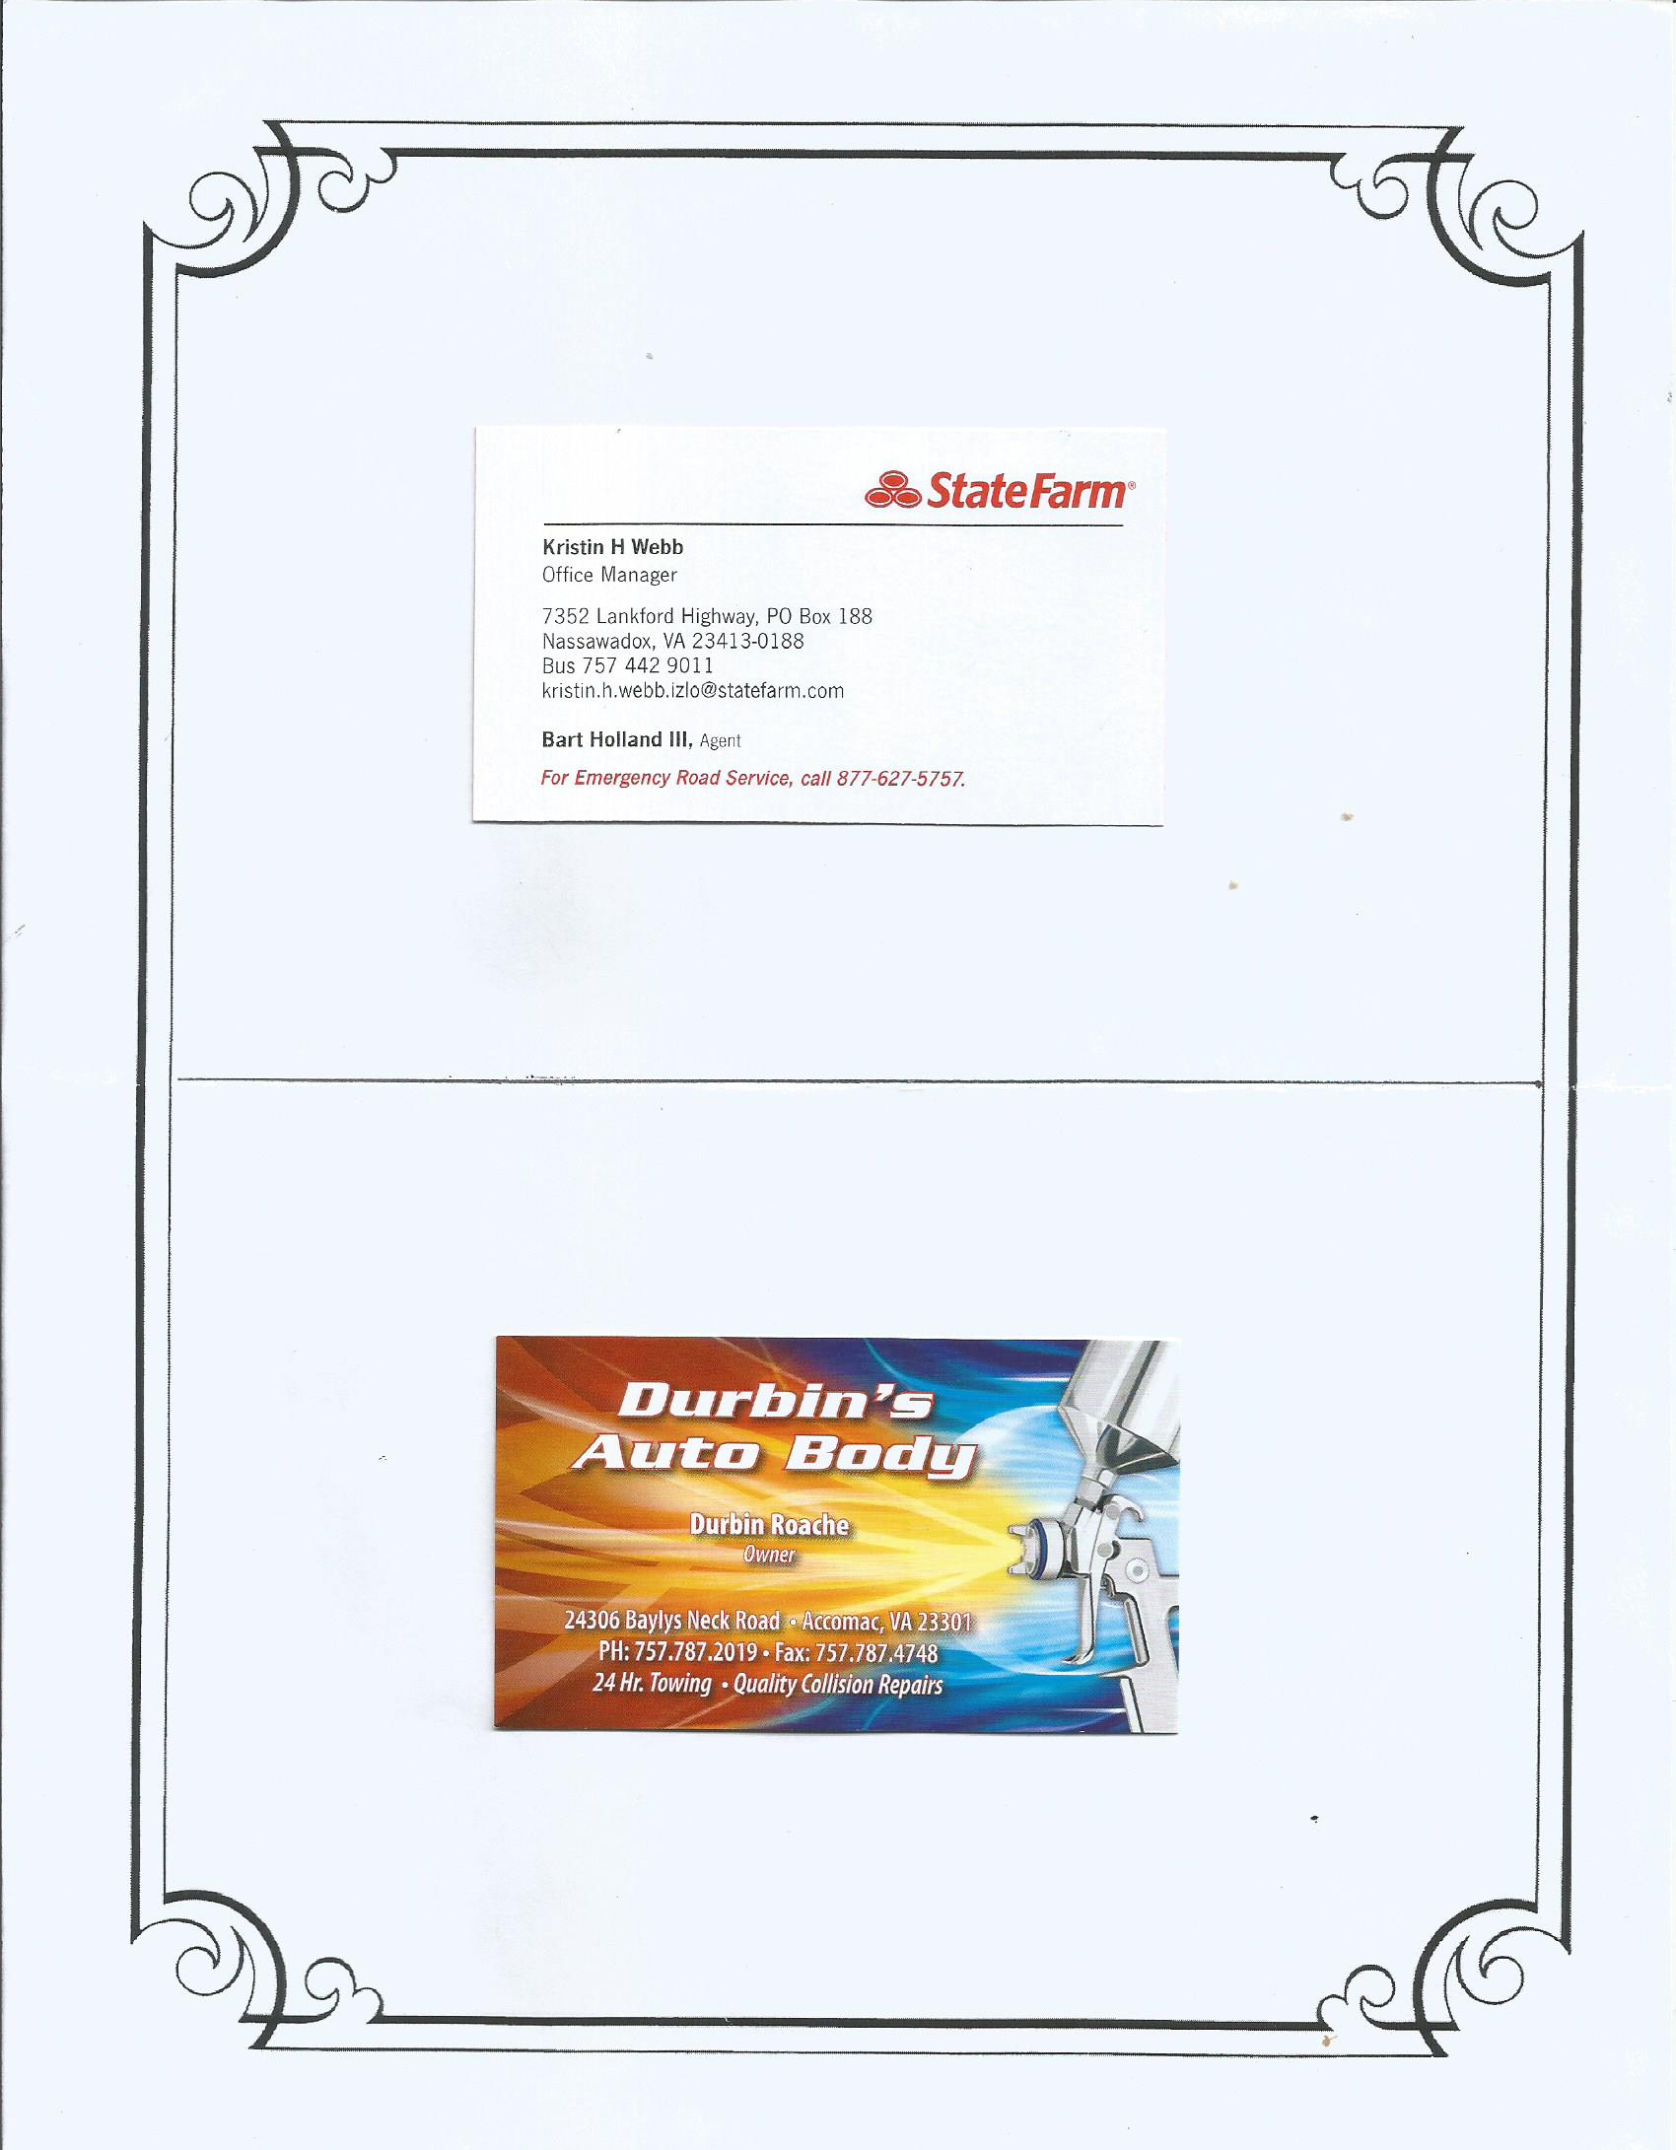

Slide 8
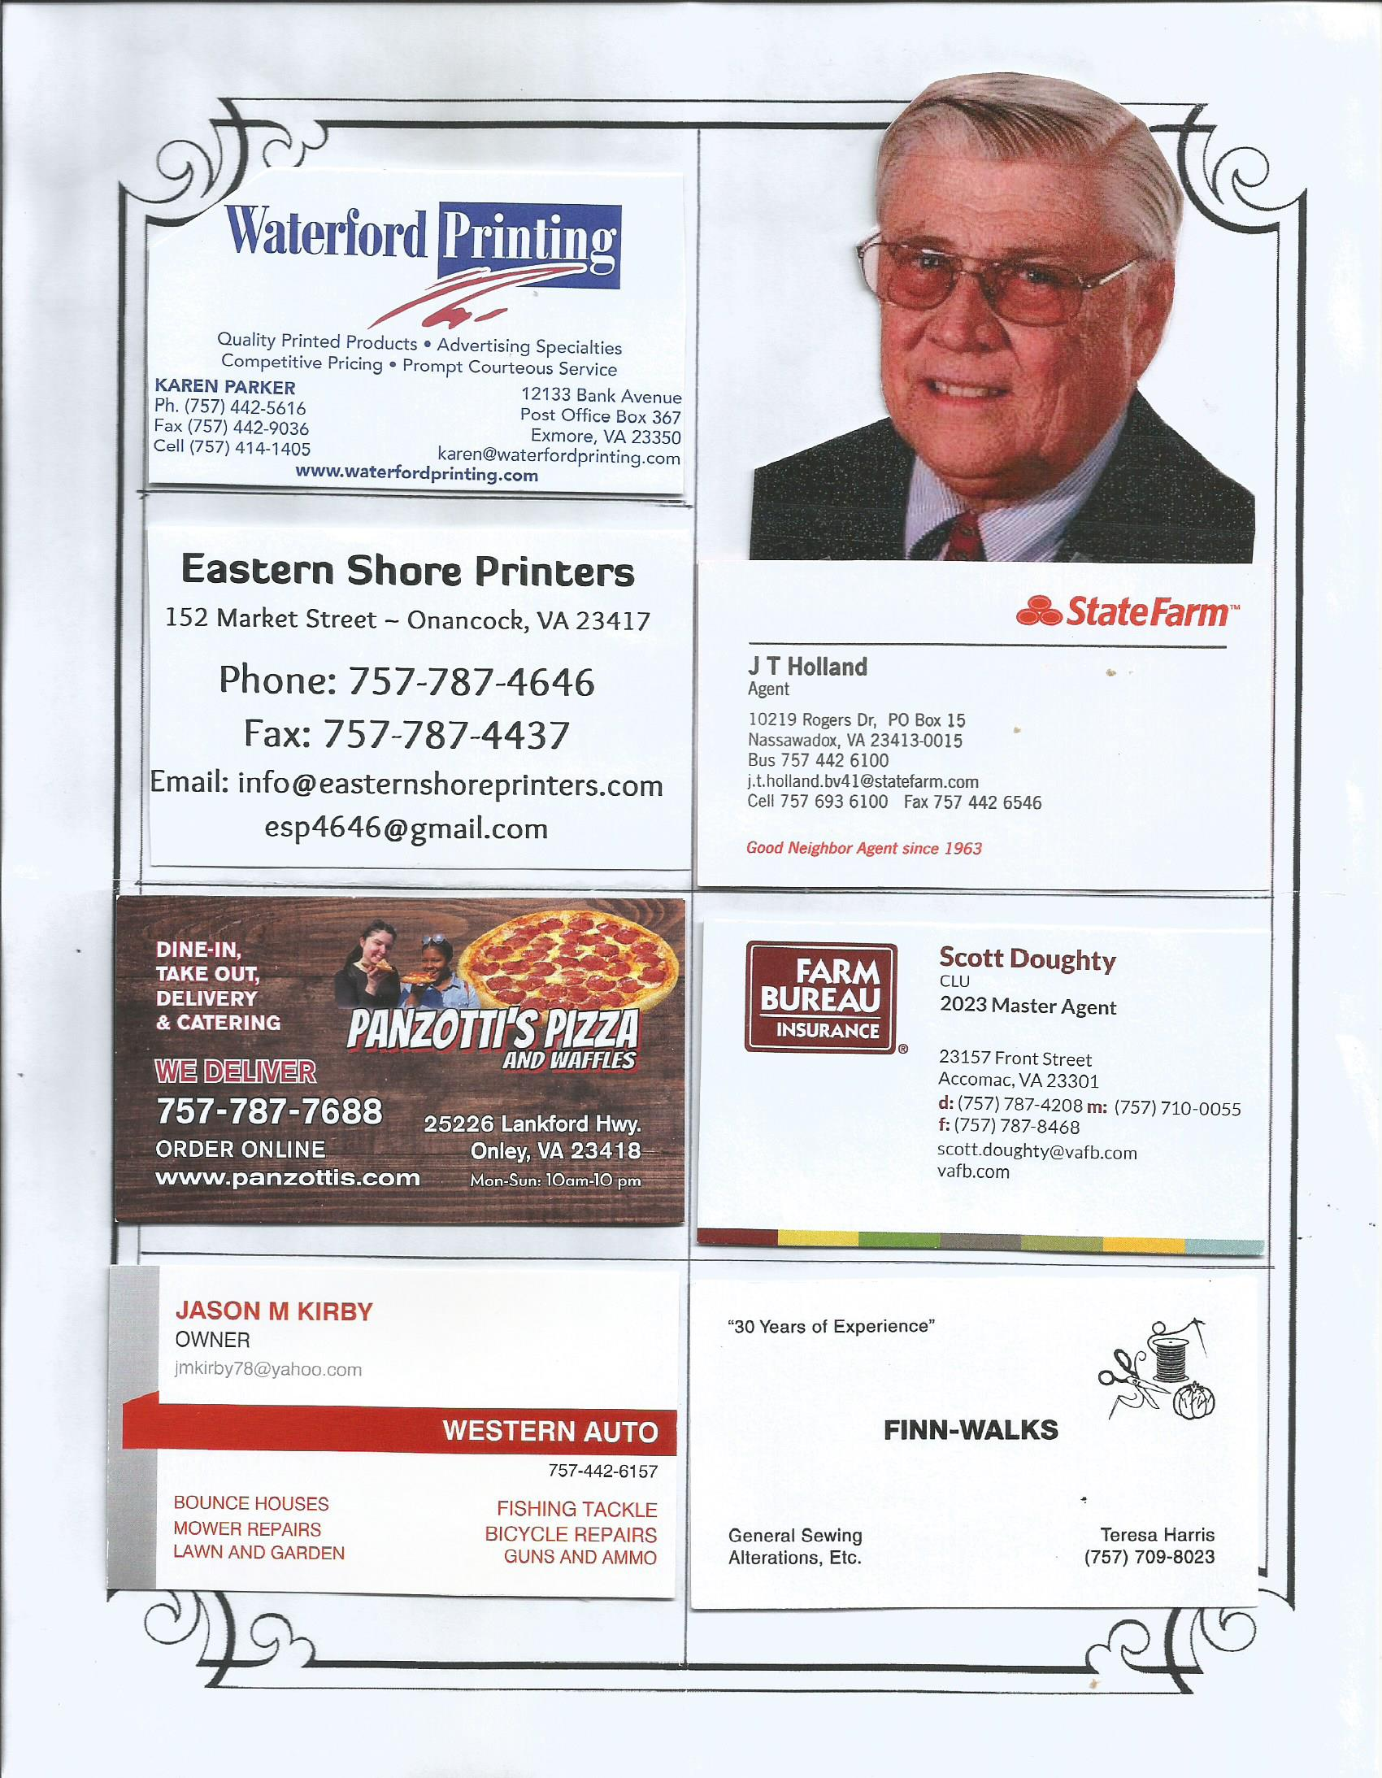

Slide 9
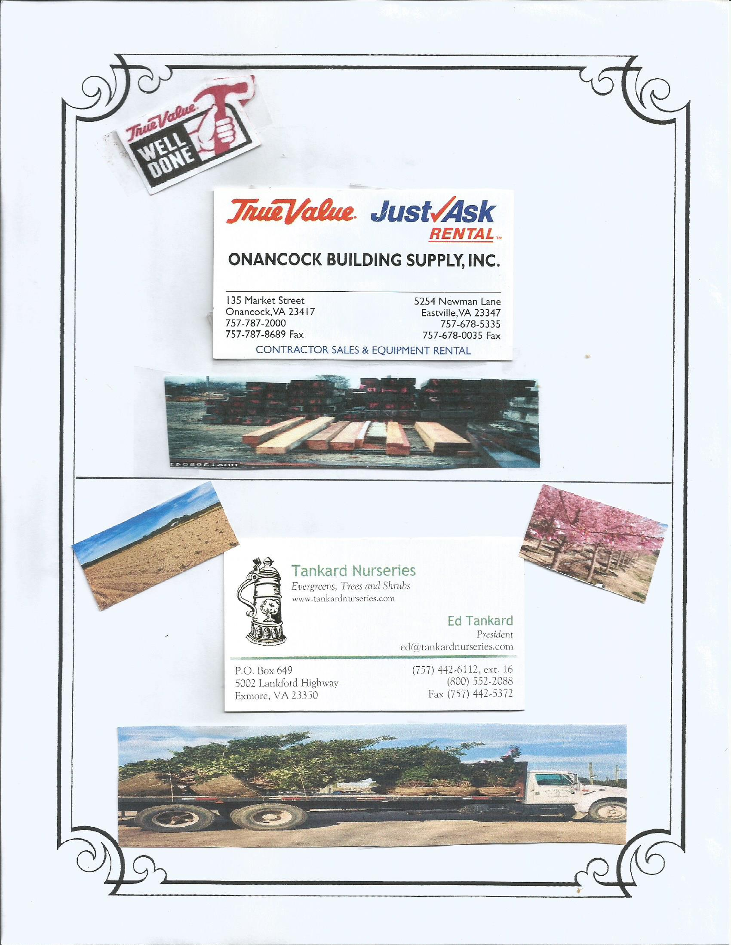

Slide 10
